Slide 1
Presentation about our work at the centre
Inez Barbé
Sien De Lathauwer

Slide 2
Our shedule
DLA
Groups therapy : sherborne, shantala massage, snoezeling
Groups therapy with the bigger children
Therapeutic play
DLA
Preperation the individual therapies (materials, arranging the space)
Individual therapy
Therapeutic play

Slide 3
General goals
Fine motor skills
Cognitive skills
Social skills

Slide 4
General ther apeutic approach
Actively guide
Positive empowering
Stimulation
Offer more activities in 1 therapy
Work at the level of the child

Slide 5
Groups activities + therapeutic play
Social skills
Learn to wait at there turn
Learn to control there emotions
Learn to play together
Respect for each other
Learn how to deal with materials
What did we do (medium)
Work with balloons, bubble blower, paint, parcour, balls, blocks,…

Slide 6
Individual therapy : F.M.
Fine motor skills
Strenght to manipulate materials
Handles
Eye-hand coördination
Goal oriënted reaching to objects
Visual perception
Finger dissociation
Cognitive skills
Attention
Concentration
Form recognition
Independently
Eating, brushing teeth , washing hands, clothes on and off
Correct starting posture
Learn how to use materials save en correct
Uses the right staps

Slide 7
Individual therapy : W.M
Fine motor skills
Strenght to manipulate materials
Handles
Eye-hand coördination
Goal oriënted reaching to objects
Visual perception
Cognitive skills
Attention
Concentration
Form recognition
Color recognition
Independently
brushing teeth , washing hands, clothes on and off
Correct starting posture

Slide 8
Individual therapy : K.K.
Fine motor skills
Strenght to manipulate materials
Handles
Eye-hand coördination
Goal oriënted reaching to objects
Visual perception
Cognitive skills
Attention
Concentration
Form recognition
Independently
brushing teeth , washing hands

Slide 9
Individual therapy : A.K.
Fine motor skills
Strenght to manipulate materials
Handles
Eye-hand coördination
Goal oriënted reaching to objects
Visual perception
Cognitive skills
Attention
Concentration
Independently
Eating, brushing teeth , washing hands
Learn how to use materials save en correct
Behaviour
Learning not to throw with everything (uses materials the wright way)

Slide 10
Individual therapy : P.A.
Fine motor skills
Goal oriënted reaching to objects
Learning to hold something
Grape
Basal stimulation
Posture
Learn to sit straight
Stimulate to crawl

Slide 11
Individual therapy : A.G.
Fine motor skills
Learning to hold something
Grape
Basal stimulation
Posture
Stimulate to sit straight
Train pelvic muscles

Slide 12
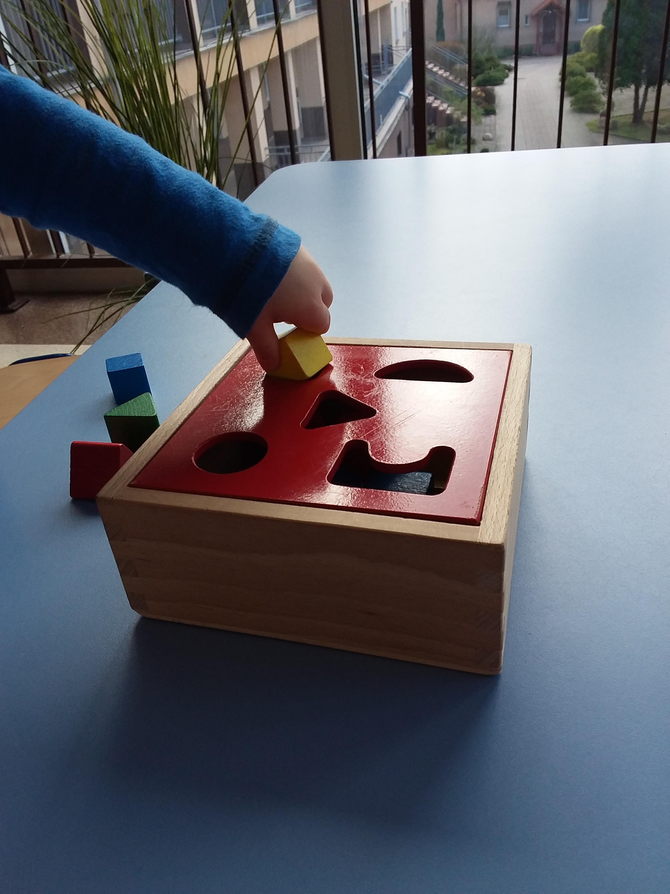
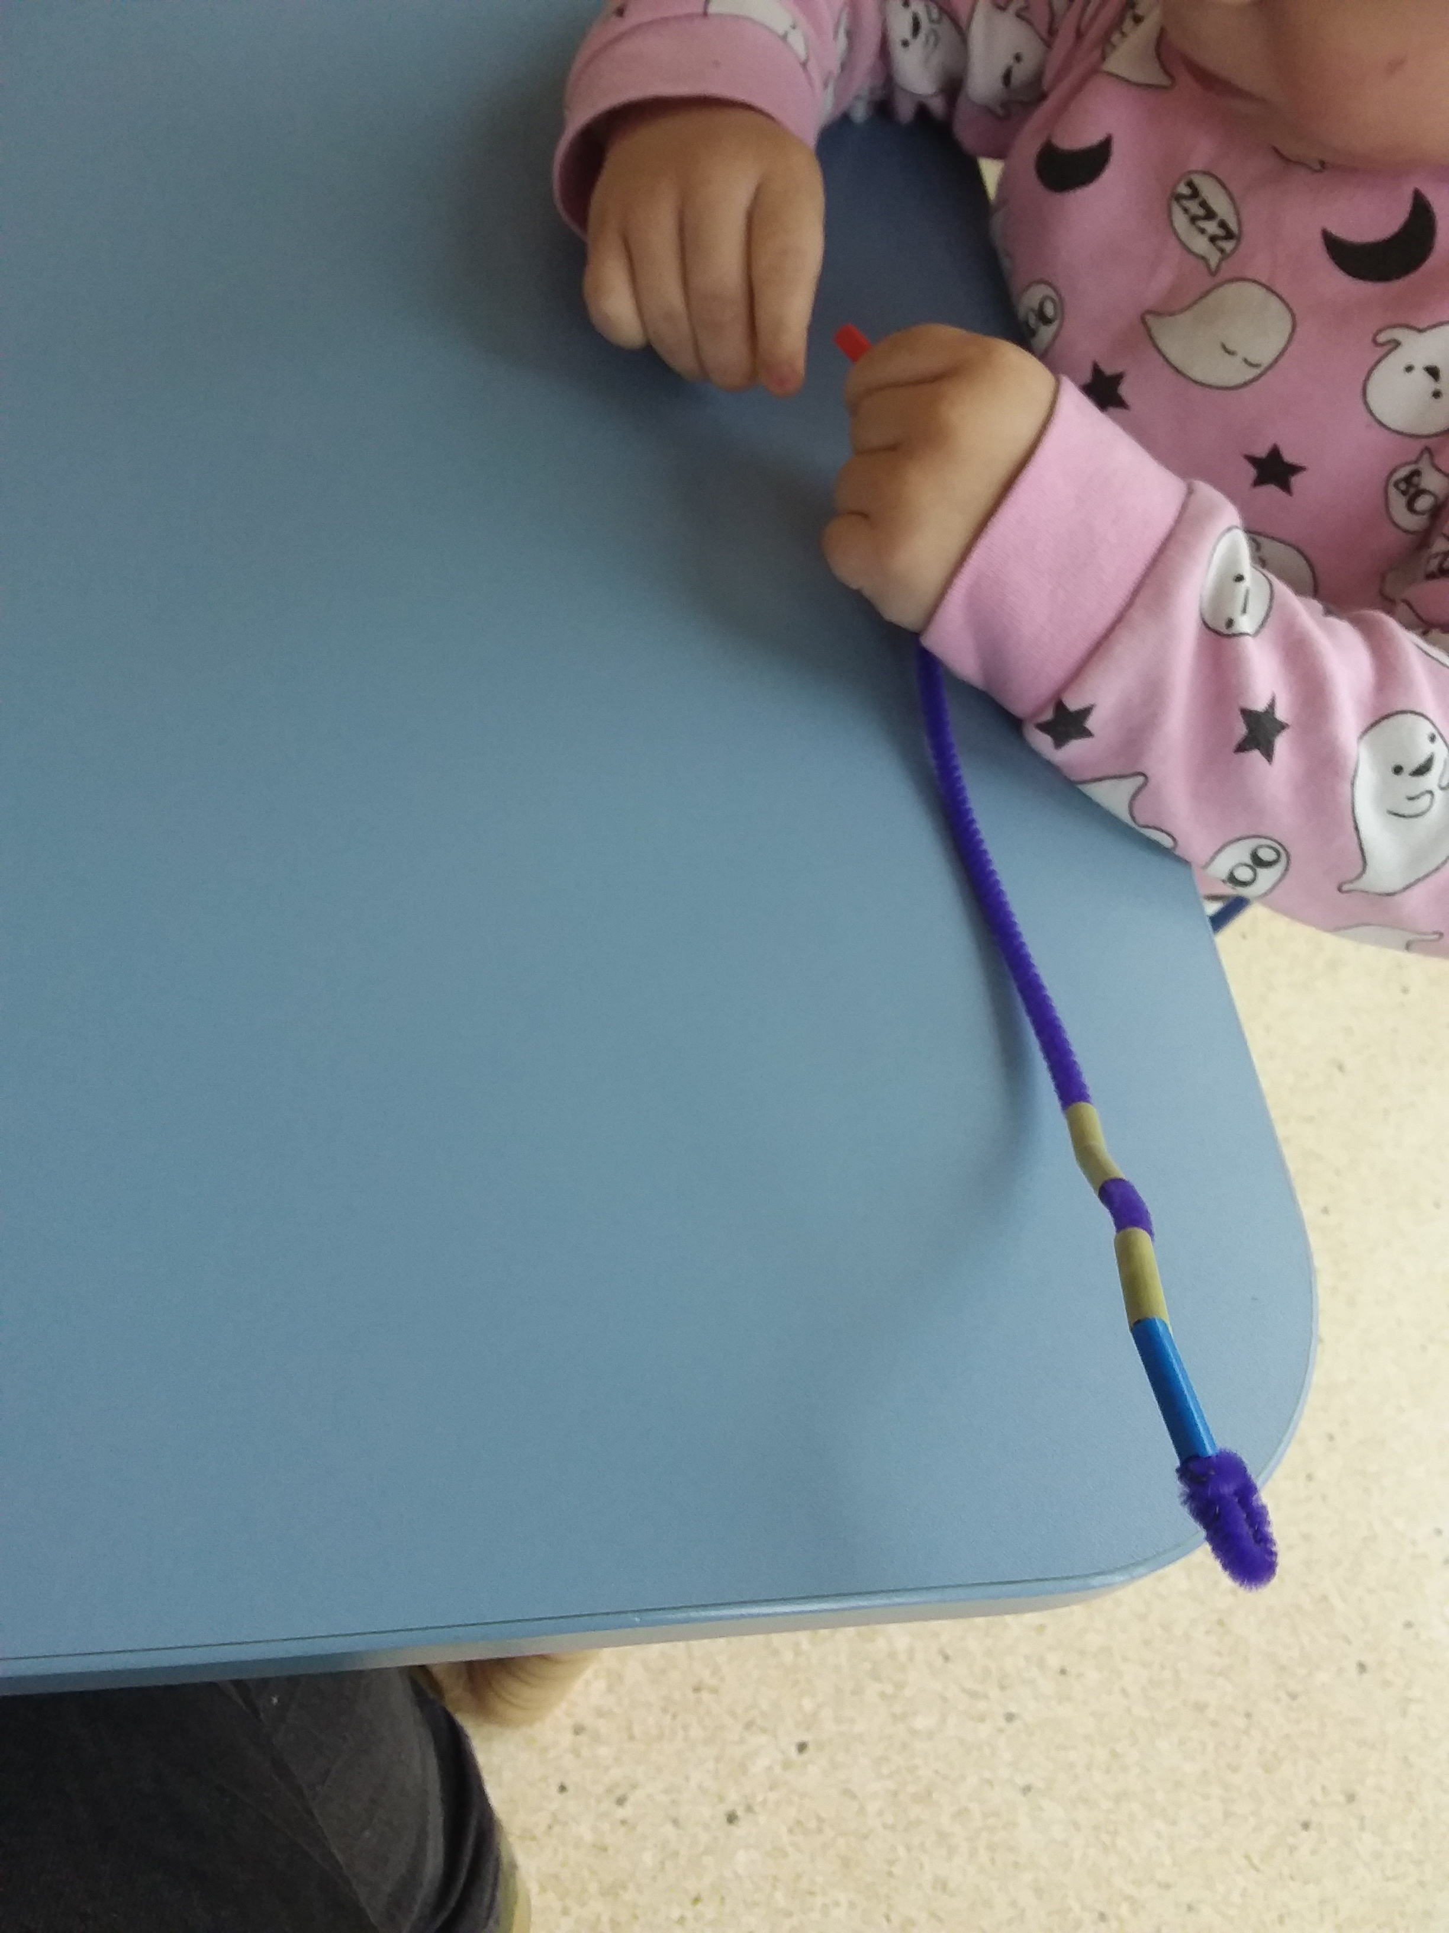
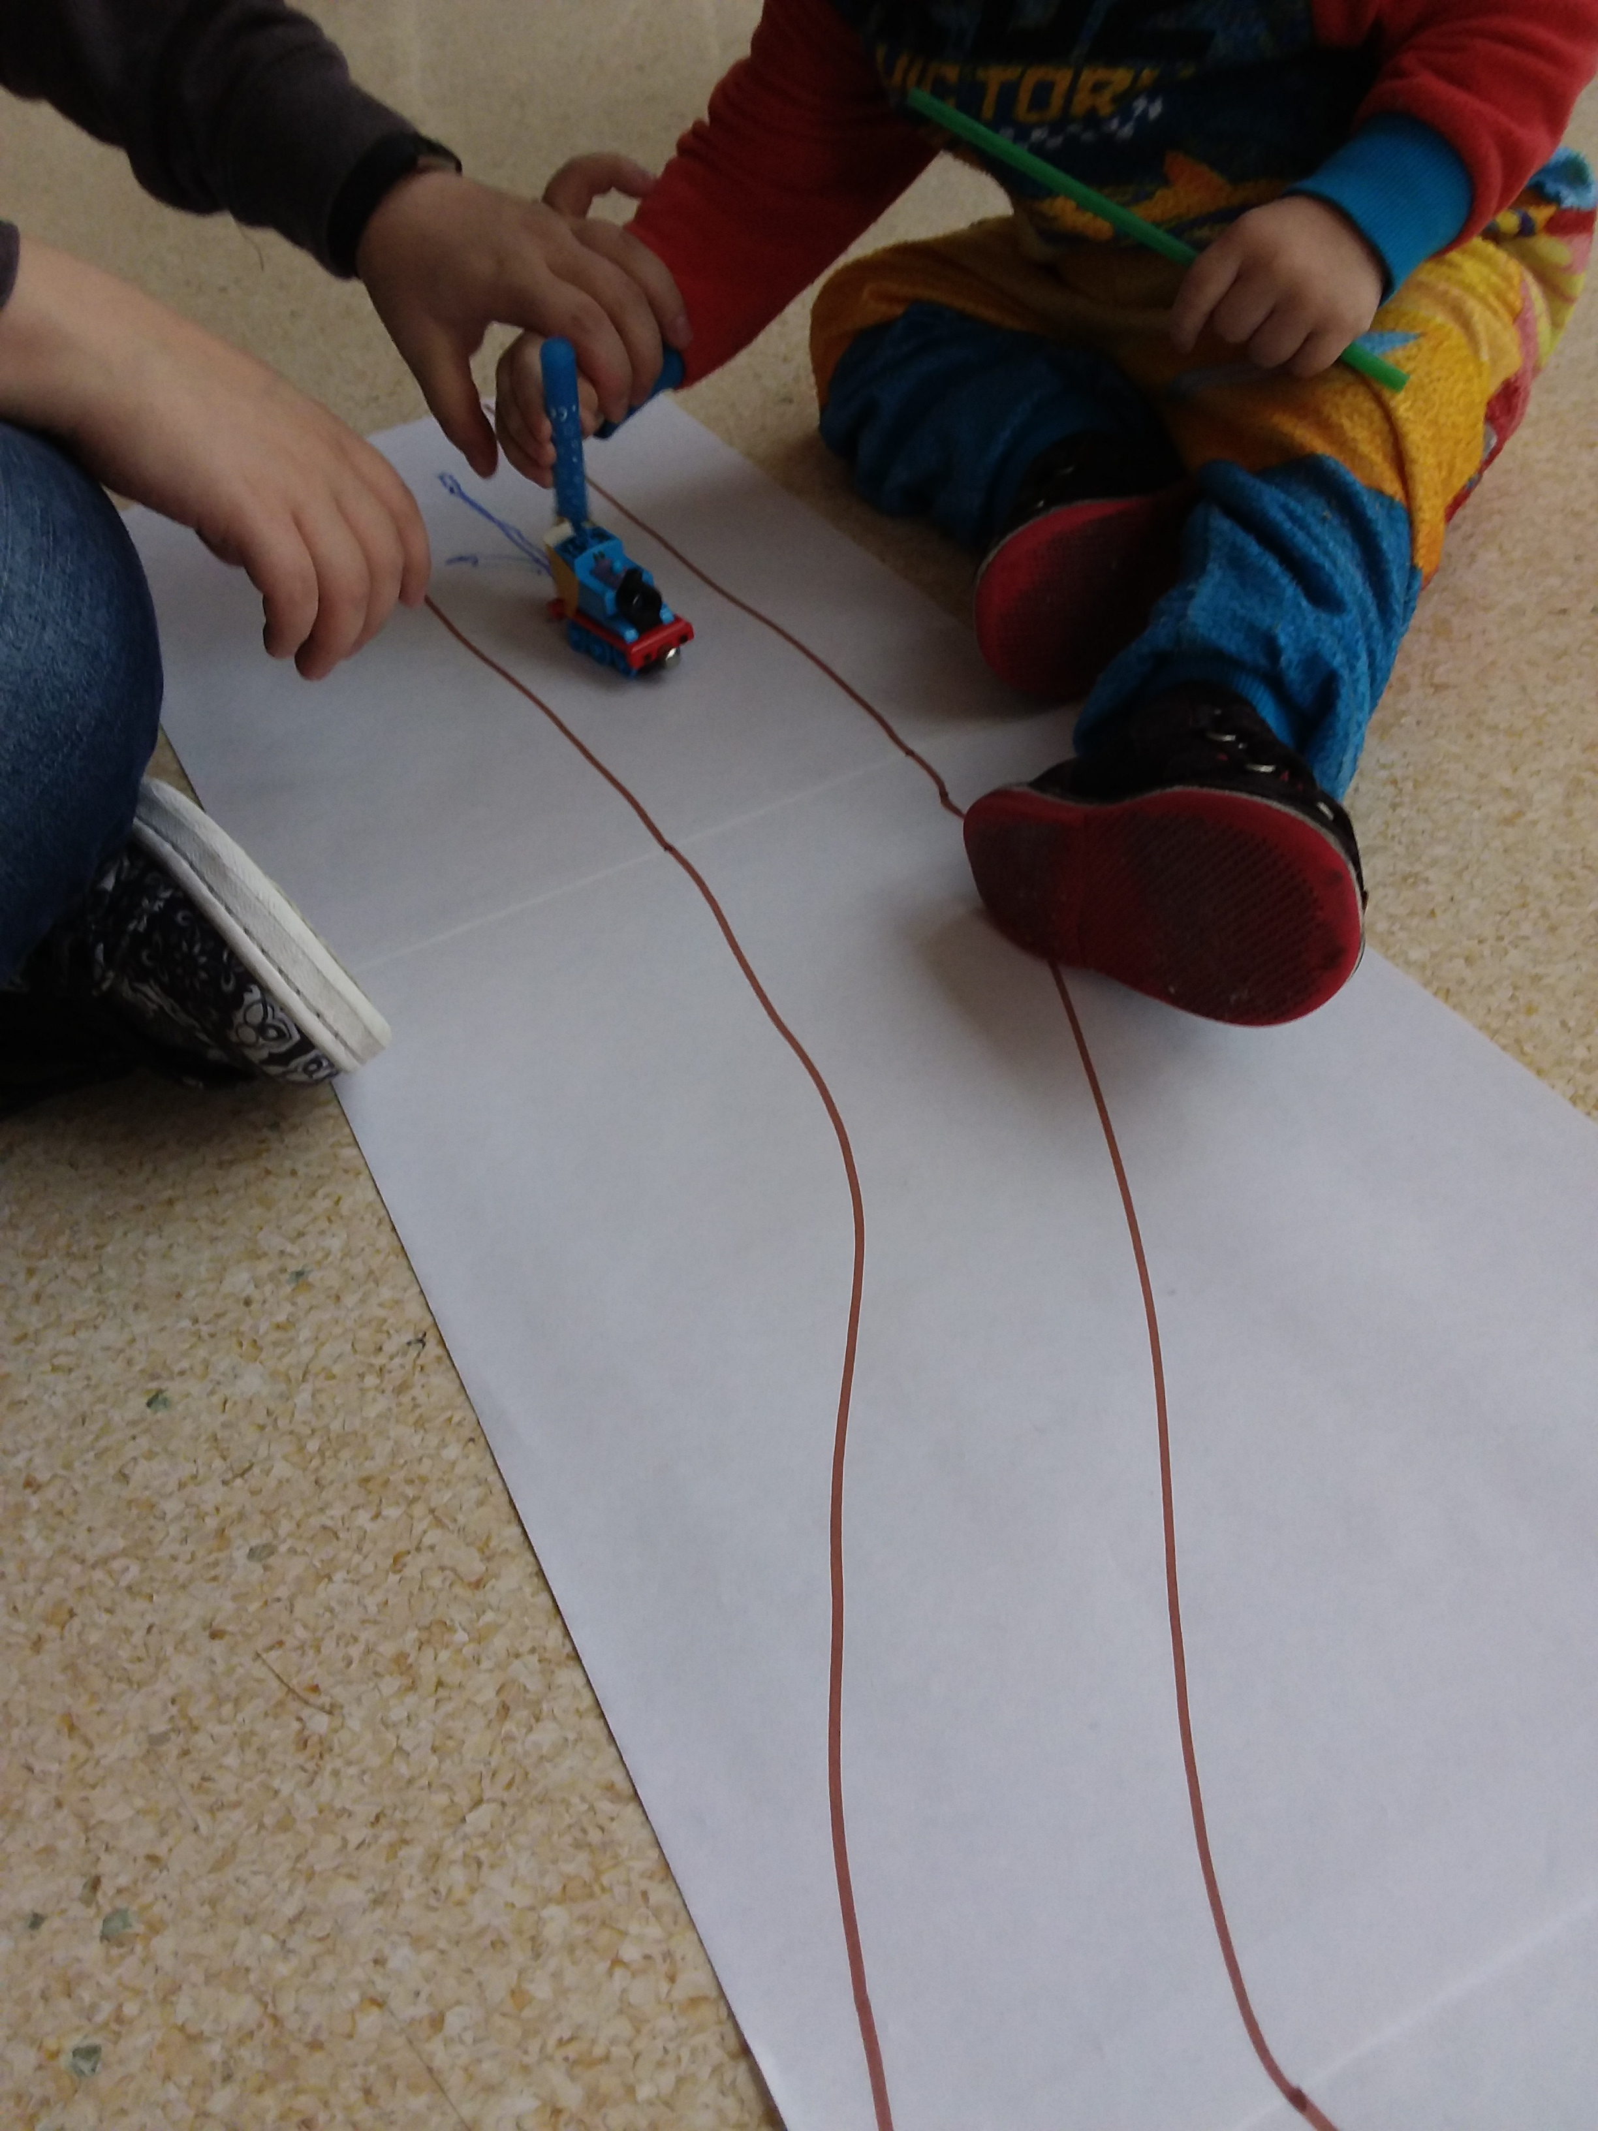
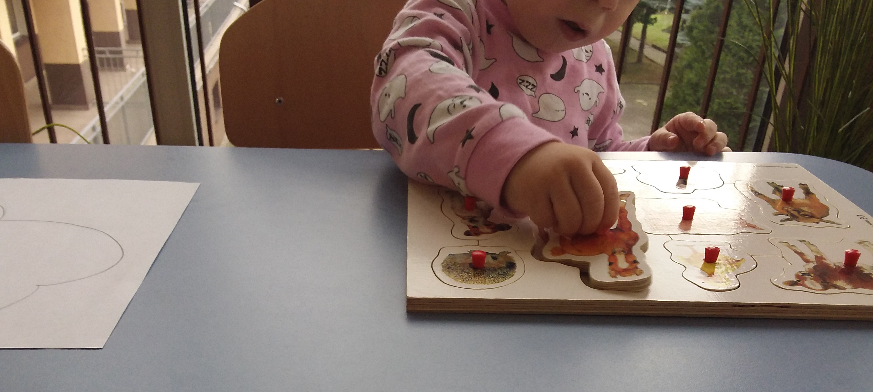
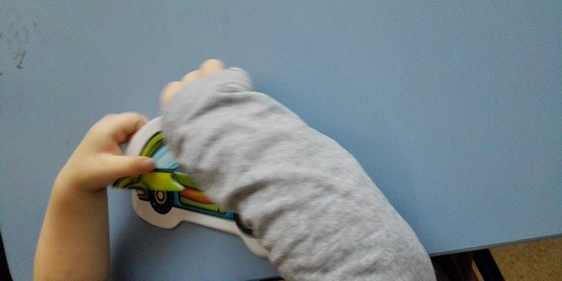
Medium bigger children

Slide 13
